Slide 1
Workforce Development Spotlight: April 2022 A Summary of Upcoming Career Compass and WFD Opportunities
New Content Coming Your Way!
The ECA to IDP Cycle
This year’s ECA to IDP Cycle is now open!
Taking the Employee Competency Assessment (ECA) is the first of four important steps associated with participating in the Career Compass program. All employees are asked to take their ECA by 15 Apr. More details: https://www.navfac.navy.mil/jobs/workforce-development/ccrc/emp_resources/eca.html
Completing an Individual Development Plan (IDP) is the second step in the Career Compass program. The IDP open period will launch on 15 Apr and run through 01 Jul. CMO, Commanders, and COs are asked to send an announcement email with additional details prior to this launch. More details will be provided SEPCOR. General information is available here: https://www.navfac.navy.mil/jobs/workforce-development/ccrc/emp_resources/idp.html
SYSCOM Training Opportunities
NAVFAC’s annual Leadership Programs application period is open through 27 May. More details: https://www.navfac.navy.mil/jobs/workforce-development/ccrc/emp_resources/leadership_dev_programs.html
Please see the following page for additional opportunities. The Career Compass Event Calendar includes upcoming learning opportunities and trainings across the SYSCOM. More details: https://www.navfac.navy.mil/jobs/workforce-development/ccrc/event-calendar.html
On-Demand Webinars and Resources Coming This Month
Influencing and Negotiating (mid-Apr):
On-Demand Webinar: Seven Ways to Build Your Influence at Work (Awareness/Basic)
https://www.navfac.navy.mil/jobs/workforce-development/ccrc/emp_resources/comp_dev_content/influencing-negotiating.html
For additional details, please talk to your local Civilian Training Advocate (BD17).
*Note: If you are unable to copy and paste the links above, QR codes are available on the following page.

Slide 2
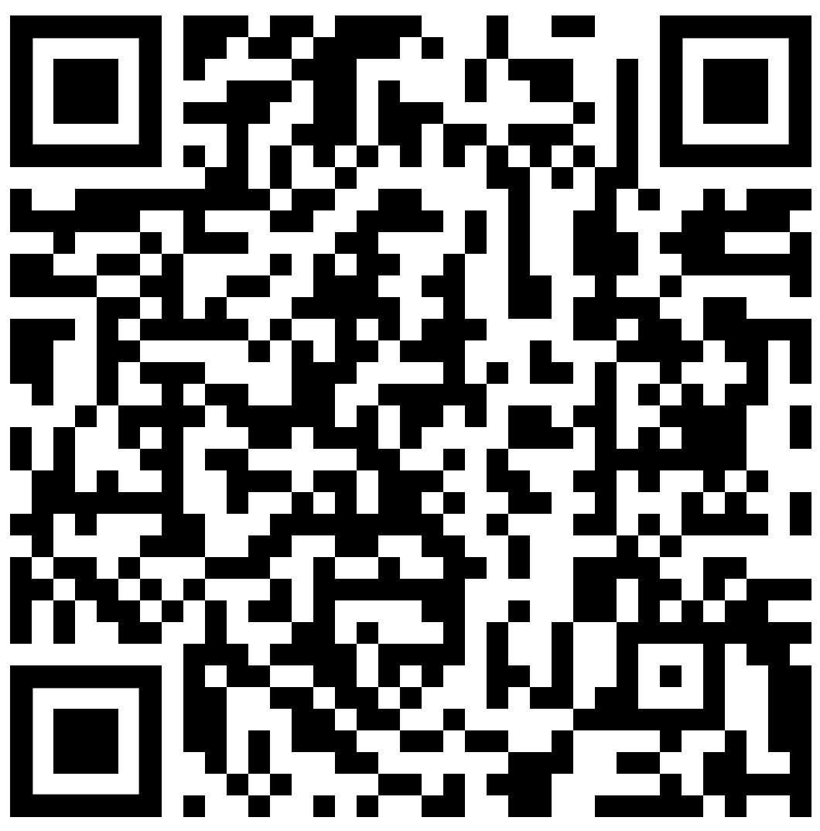
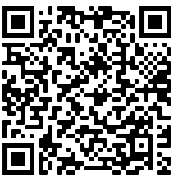
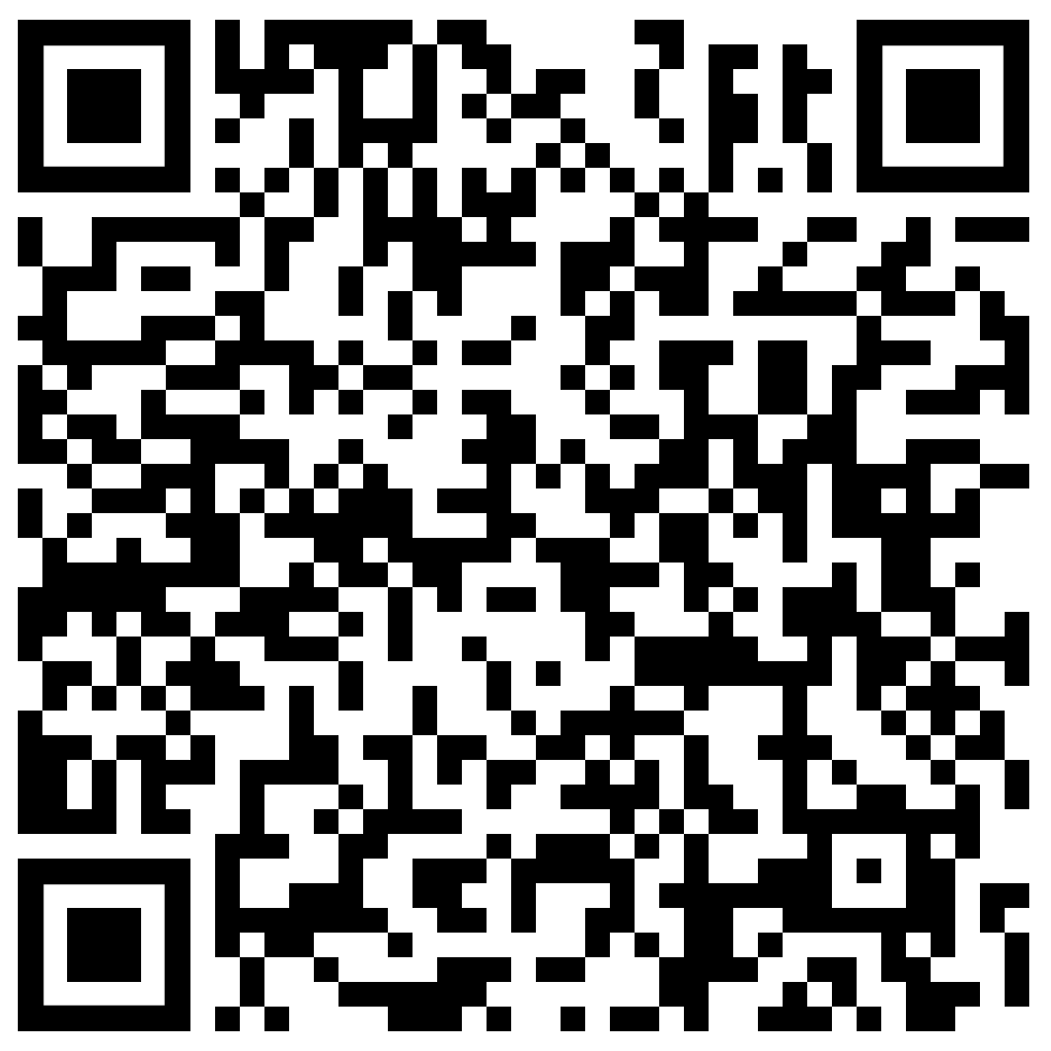
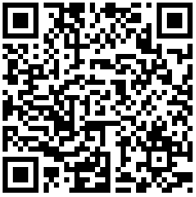
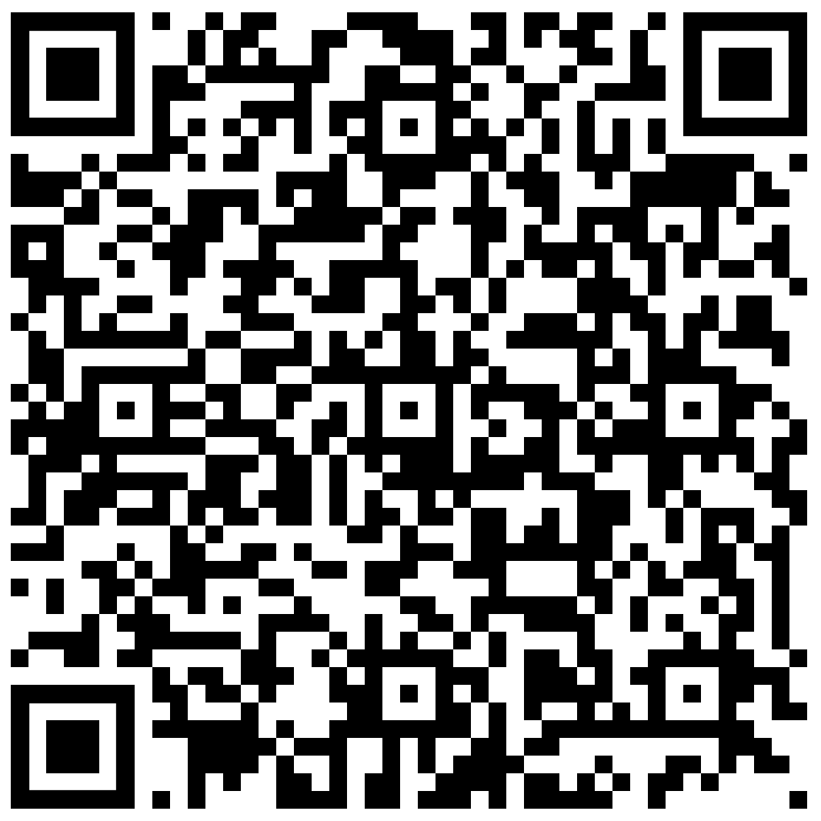
April SYSCOM Training Summary
The following QR codes can be used to access the pages referenced in the previous slide.
Start Date | Event
Mon, 04 Apr | Supervisor Academy: Current Supervisor Training, Cadre 3
Tue, 05 Apr | NFI 301: Leadership in Today's Navy (East)
Tue, 12 Apr | Project & Program Management (West)
Wed, 13 Apr | Communicating for Results (East)
Thu, 14 Apr | Project & Program Management (East)
Mon, 18 Apr | NFI 201: Team Supervisors & Emerging Leaders (West)
Wed, 20 Apr | Group Learning Program: Developing a Strategic Vision (Group 1)
Thu, 21 Apr | Group Learning Program: Developing a Strategic Vision (Group 2)
Tue, 26 Apr | NFI 301: Leadership in Today's Navy (West)
Employee Competency Assessment (ECA)
Individual
Development Plan
(IDP)
Leadership Programs
May Courses Open for Registration
Career Compass Event Calendar
Start Date | Event | Registration Deadline
Mon, 09 May | Supervisor Academy: New Supervisor Workshop, Cadre 3 (West) | 06 May
Influencing & Negotiating Competency Page

